Slide 1


UNIT 1; All about me
Friends forever

Slide 2
Adverbs of frequency
How often?
always uvijek
every day svaki dan
usually obično, redovito
often često
sometimes ponekad
rarely rijetko
never nikada
Prilozi su nepromjenjiva vrsta riječi koje se dodaju najčešće glagolima za označavanje mjesta, vremena, načina, uzroka, učestalosti radnje.
Prilozi učestalosti govore koliko se često neka radnja odvija.
Priloge učestalosti u rečenici uvijek stavljamo iza glagola biti, a ispred svih ostalih glagola.

Slide 3
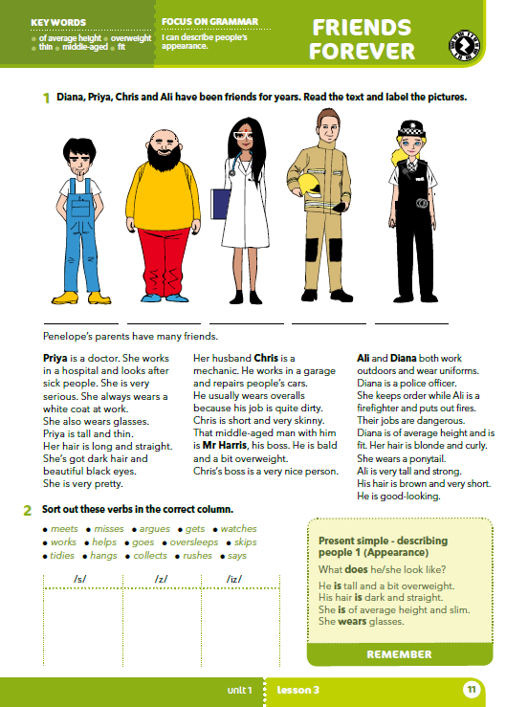
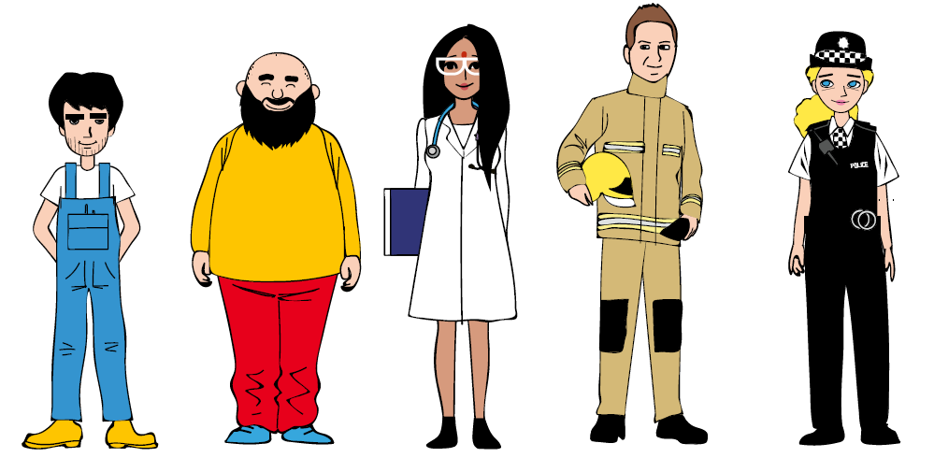
Look at the pictures.
What do you think their names are?
Which one is Priya? Who is Chris?
What does the woman in uniform do?
Does any one of them remind you of someone you know?

Slide 4
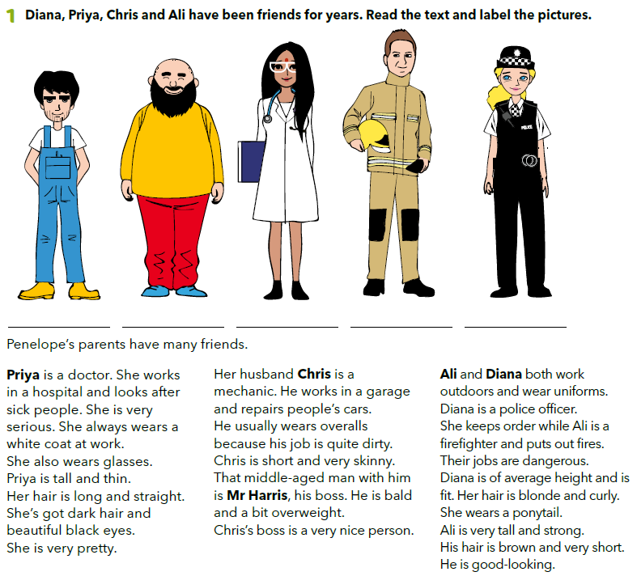
Read the text and label the pictures.
Check!
Who is the man in overall?
What does he look like?
What colour is his hair?
How tall is he?
Who is overweight?
Is Ali of avarage height?
Who is fit?
Is Mr Harris old?
Chris
Mr Harris
Priya
Ali
Diana

Slide 5
PLAY THE GAME https://wordwall.net/play/538/387/760
Chris
Mr Harris
Priya
Ali
Diana

Slide 6
What do they all have in common?
What does Chris do?
Where does he work?
Does he repair planes?
Why does Chris wear overalls?
What does Priya wear at work?
What does Mr Harris do?
What does a police officer do?
Chris
Mr Harris
Priya
Ali
Diana

Slide 7
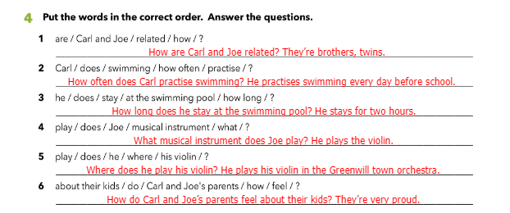

Slide 8
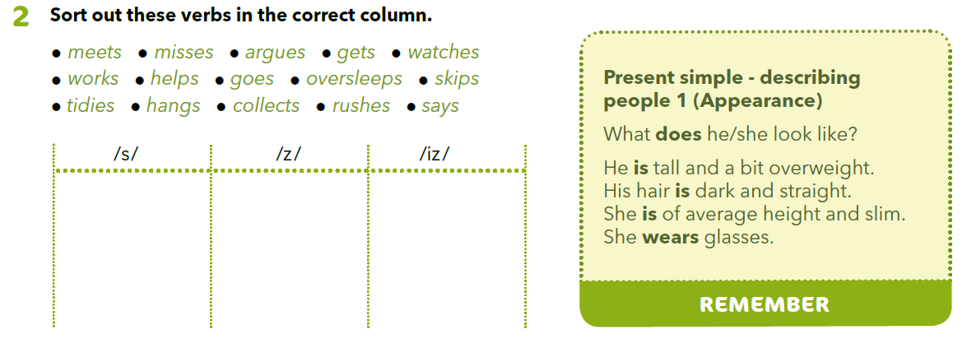
Present Simple - nastavak –s ili –es izgovaramo ovisno o glagolu kao /s/, /z/ ili /iz/.
meets
argues
misses
gets
hangs
watches
works
says
tidies
helps
rushes
goes
oversleeps
skips
collects

Slide 9
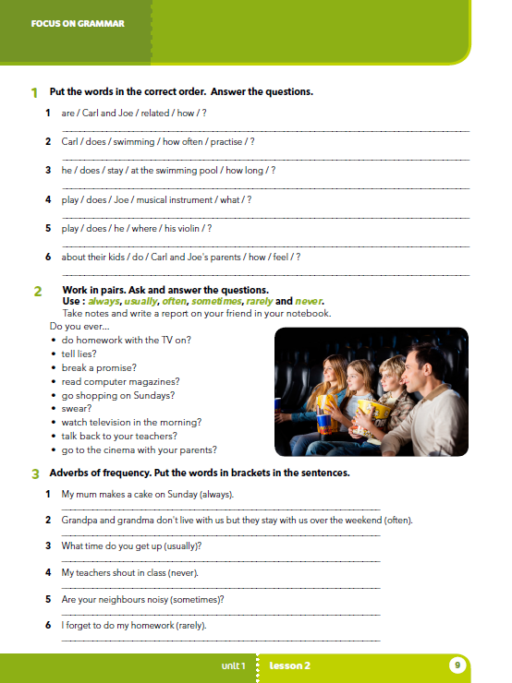
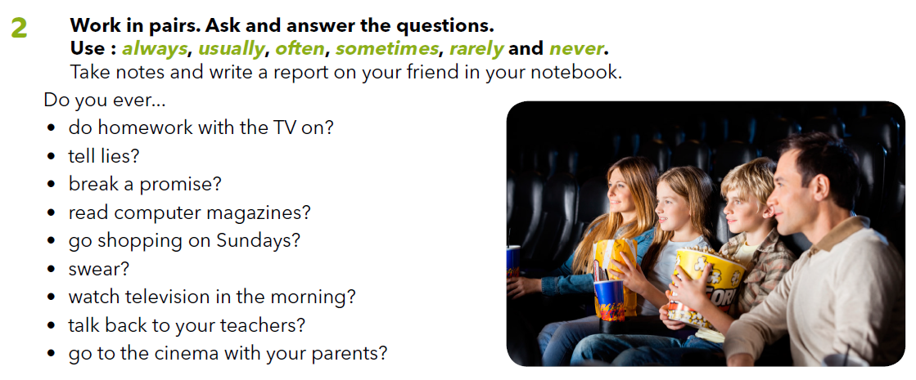
Send a text or call your friend and ask him/her questions from task 2. Write.

